Slide 1
MY ISSUES FINAL REVIEW
Anzi xu zhou
bOrja escobar briega
Manuel martín-consuegra López
Marcos muelas Aspano
Ping Wang chen

Slide 2
SPRINT ROLES
Anzi Xu Zhou: GUI designer, GUI programmer
Borja Escobar Briega: GUI designer
Manuel Martín-Consuegra López: mock-up designer and navigation flow designer, GUI designer, GUI programmer
Marcos Muelas Aspano: mock-up designer, GUI designer, presentation designer
Ping Wang Chen: GUI designer

Slide 3

INDEX
WORK DONE
FOUND PROBLEMS
CONCLUSIONS
DEMO

Slide 4
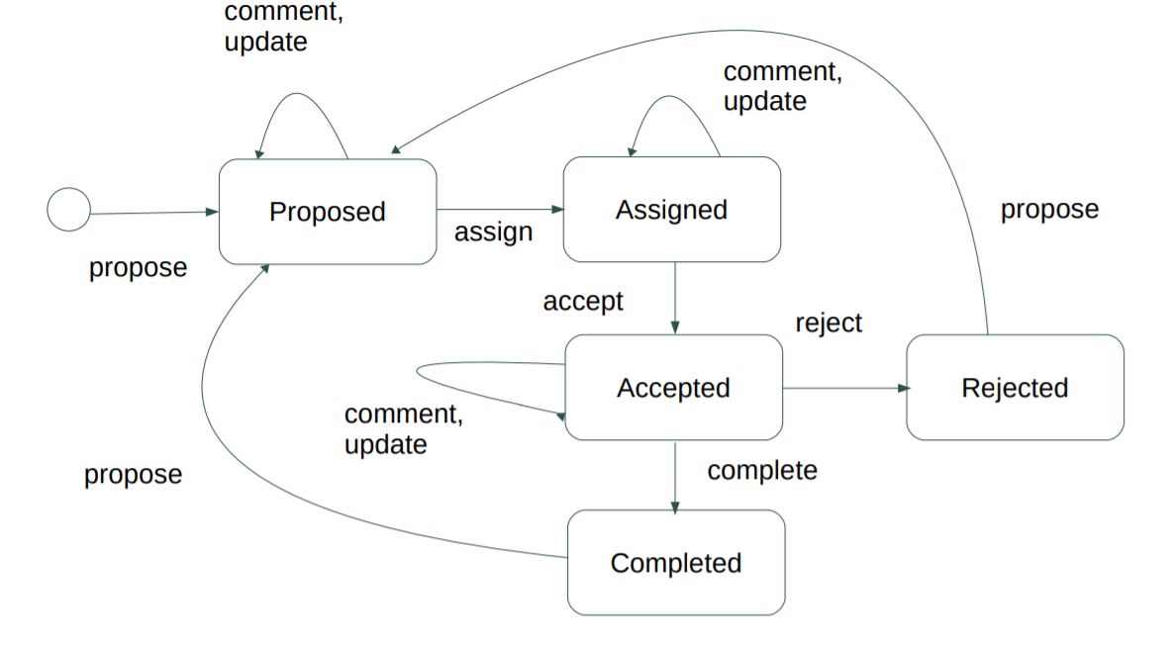
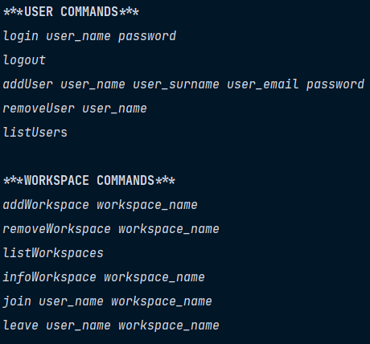
WORK DONE – Integrating a command appliacation
ISSUES FLOW
EXAMPLE OF THE COMMANDS

Slide 5
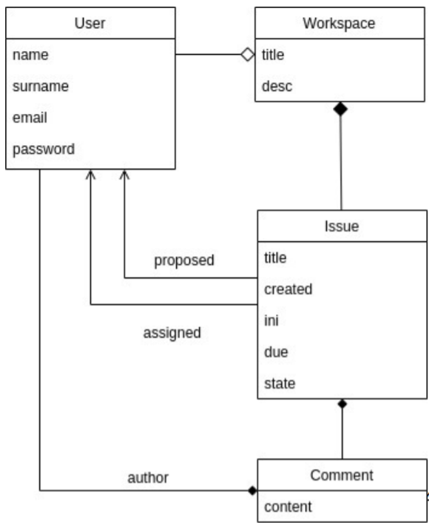
WORK DONE – connecting to the data base
FIRST DATABASE SCHEME
DB
CLIENT
SERVER

Slide 6
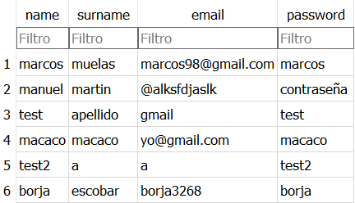
WORK DONE – connecting to the data base
USER TABLE EXAMPLE
DB
CLIENT
SERVER

Slide 7

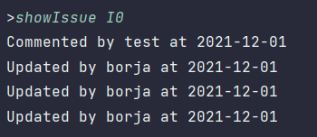
WORK DONE – adding new commands
showIssue

Slide 8
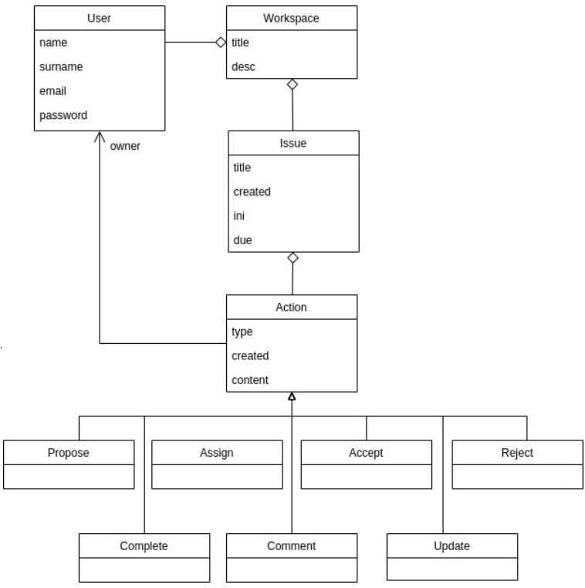

WORK DONE – DATA BASE SCHEME UPDATE
FIRST SCHEME
UPDATED SCHEME

Slide 9
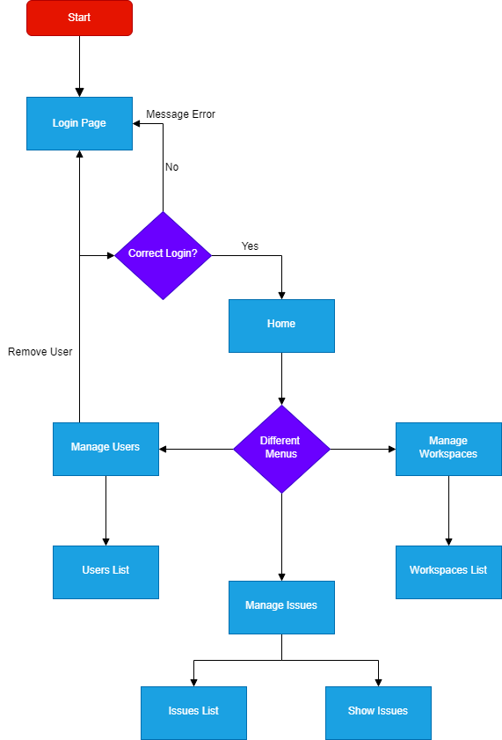
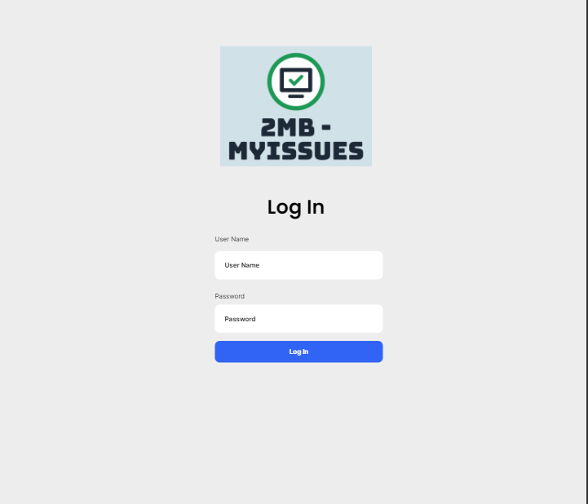
WORK DONE – GUI DEVELOPMENT
NAVIGATION FLOW
MOCK-UP
*MADE IN https://draw.io/
*MADE IN https://app.uizard.io/

Slide 10



WORK DONE – GUI implementation
GUI TECHNOLOGY - JAVAFX
MODEL
UPDATES
MANIPULATES
VIEW
CONTROLLER
JAVAFX DESING - SCENE BUILDER
SEES
USES

Slide 11
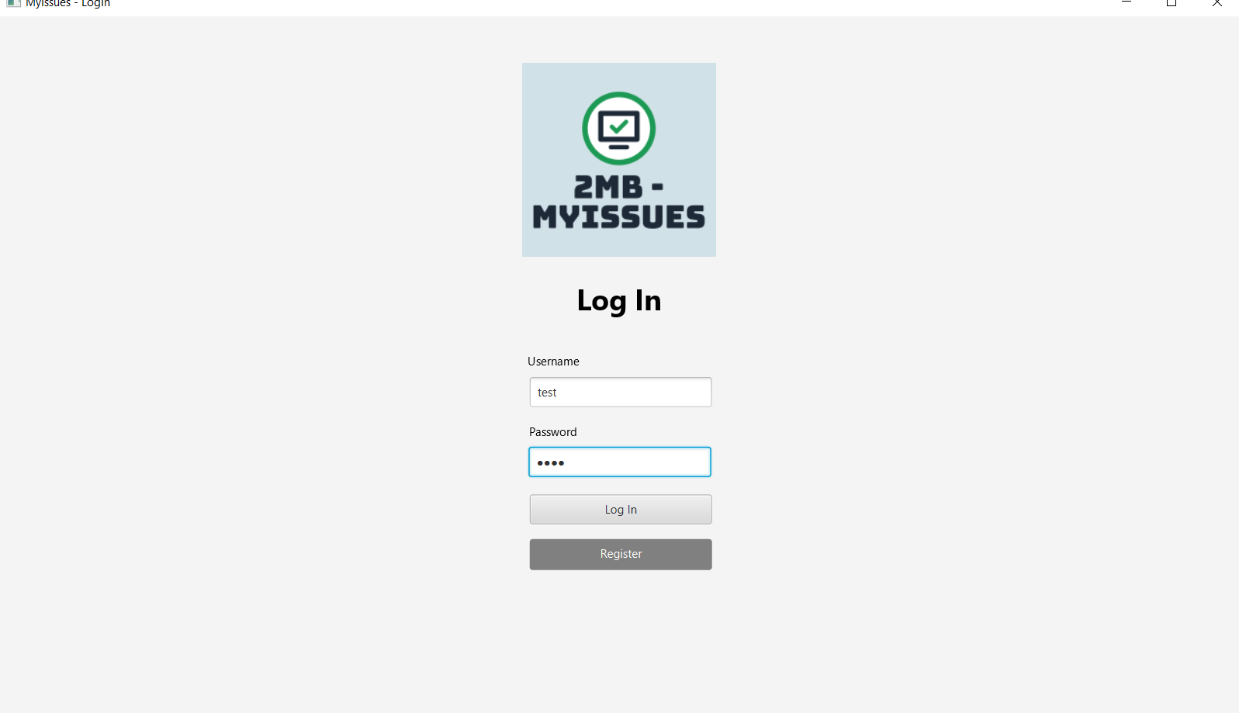

WORK DONE – GUI DEVELOPMENT
MOCK-UP
FINAL GUI

Slide 12

FOUND PROBLEMS
Connect GUI with server
Connect the buttons of the views with the controllers
Connect the GUI project with the functions of server (not the same that connect with server)
Execute more than 2 actions in the same session
Show a list of elements on the view
Error adding JavaFX Mavels

Slide 13
conclusions
In conclusion, the creation of the GUI of the practice should be the simplest and fastest sprint but it cost us a lot since we have had several problems such as what type of GUI to use (since the beginning we thought about using flutter), how to connect JavaFX to our project, how to connect the server to the views ... But thanks to the effort and dedication of the entire team we have managed to unite and implement everything.

Slide 14

demo

